Slide 1

Introductions
RTT4220 – Lecture #0
Kedree Proffitt
WSU
09/02/2025

Slide 2
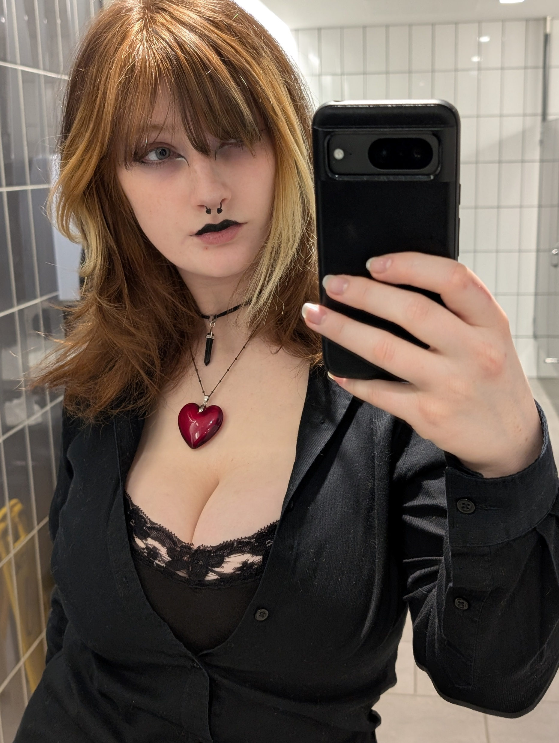
Personal Details
Kedree Proffitt (cool name, I know!)
Physics B.S. at UM-Flint
Was a Master’s Student here for Medical Physics (NOW PhD?!)
I am taken by a beautiful wonderful lady named Ryleigh
We have a cat (Tina), a kitten (Teto), two bunnies (Poppy and Kirby), and a jumping spider (Tabby)!

Slide 3
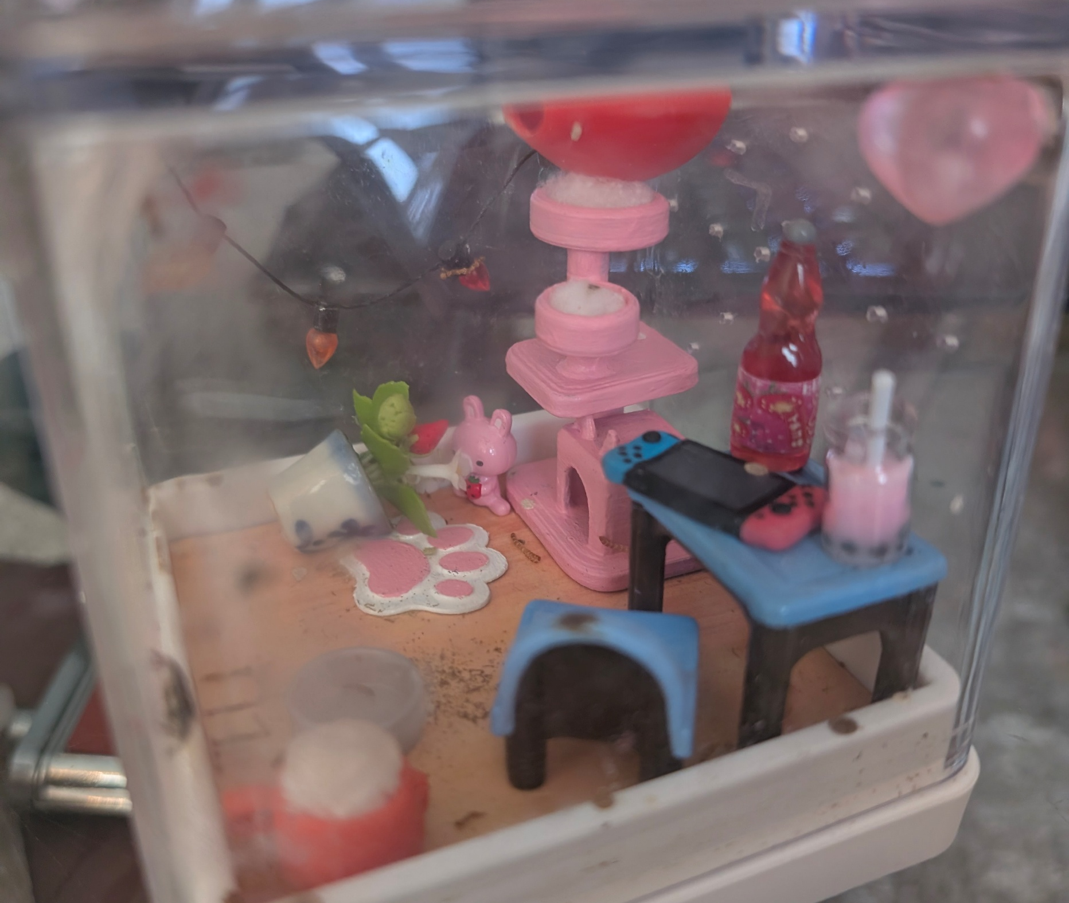
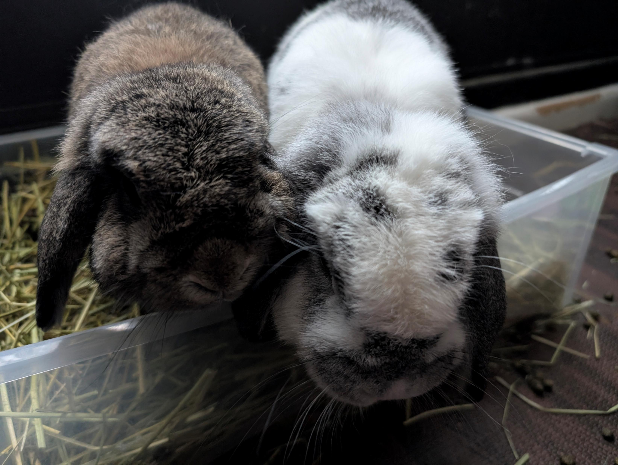
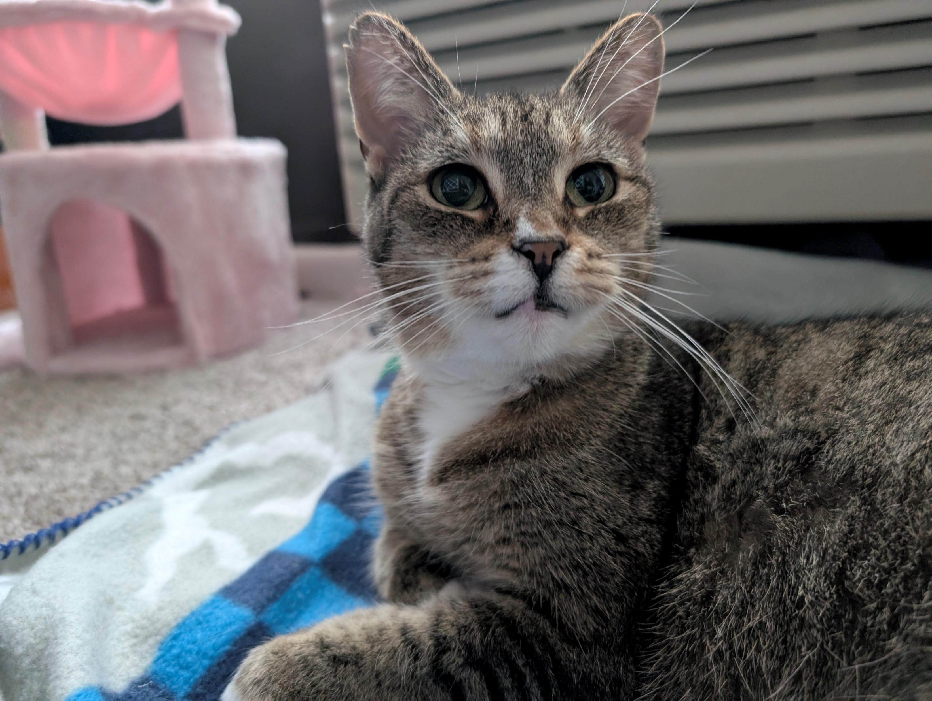
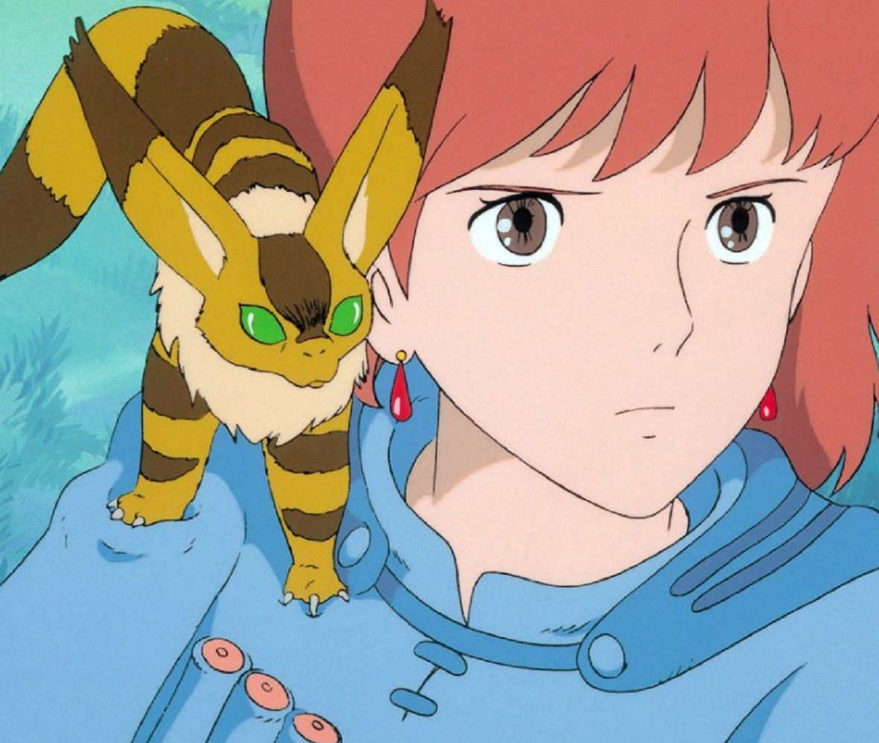
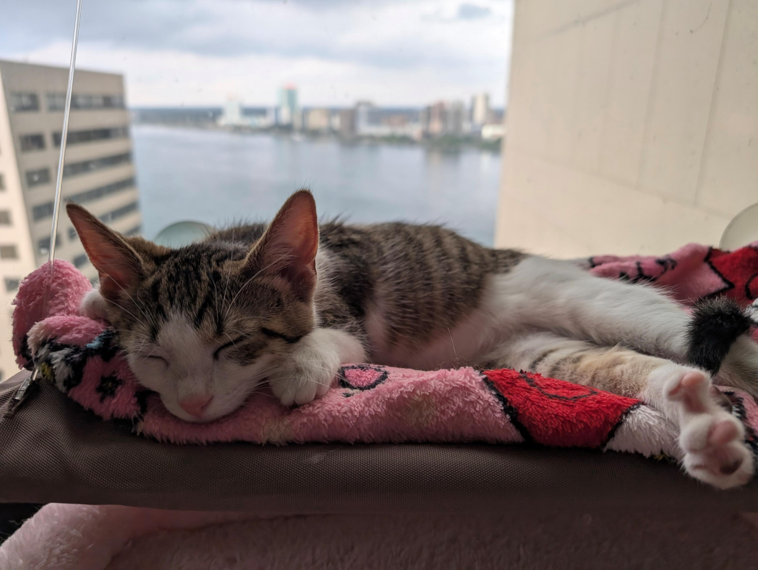


Slide 4
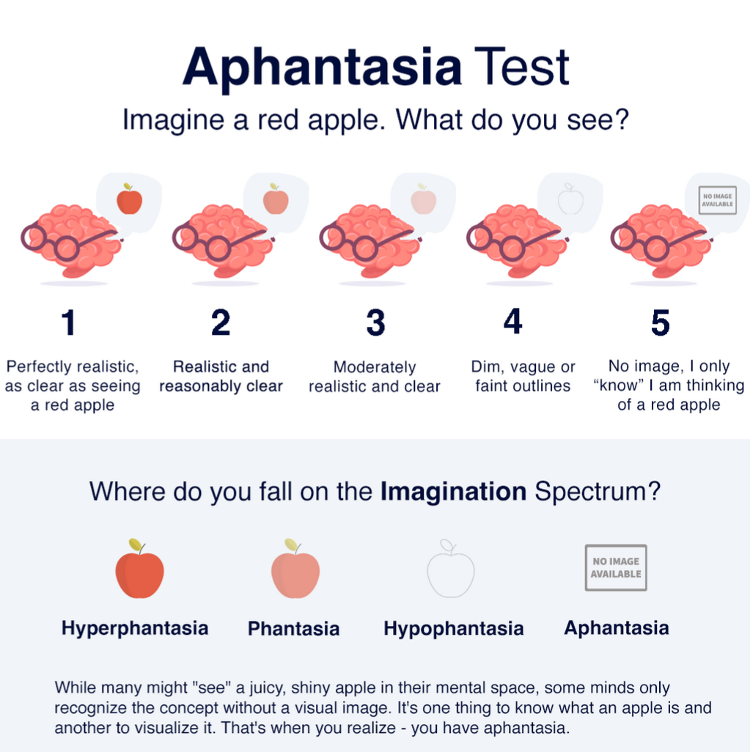
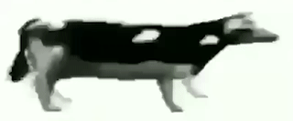
Niche Details
I have aphantasia (quite severe!)
No free movies in my head
Blessing and a curse
I’m not insane
Trauma isn’t as bad?
Physics is harder
I forget peoples faces

Slide 5
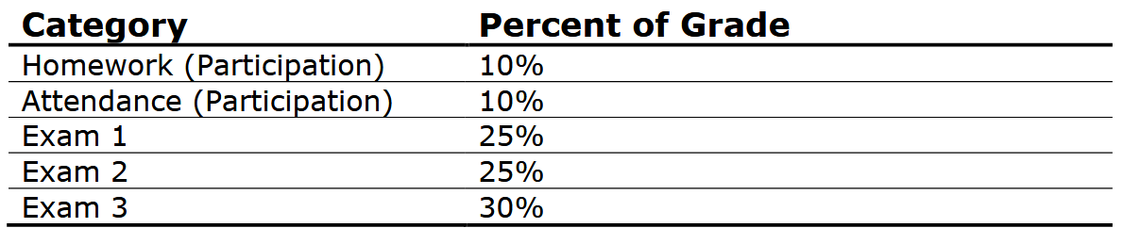
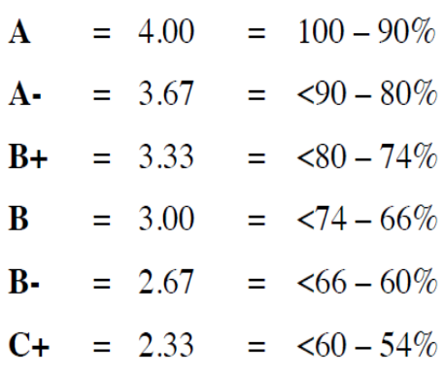
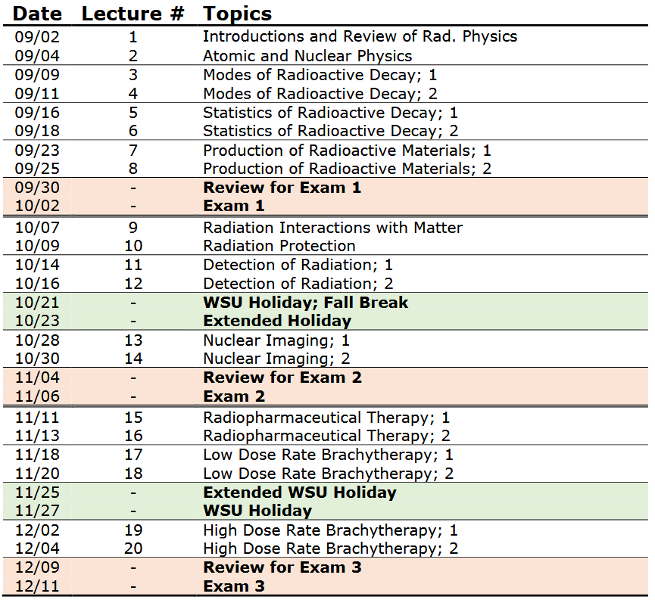
Important Syllabus Stuff

Slide 6
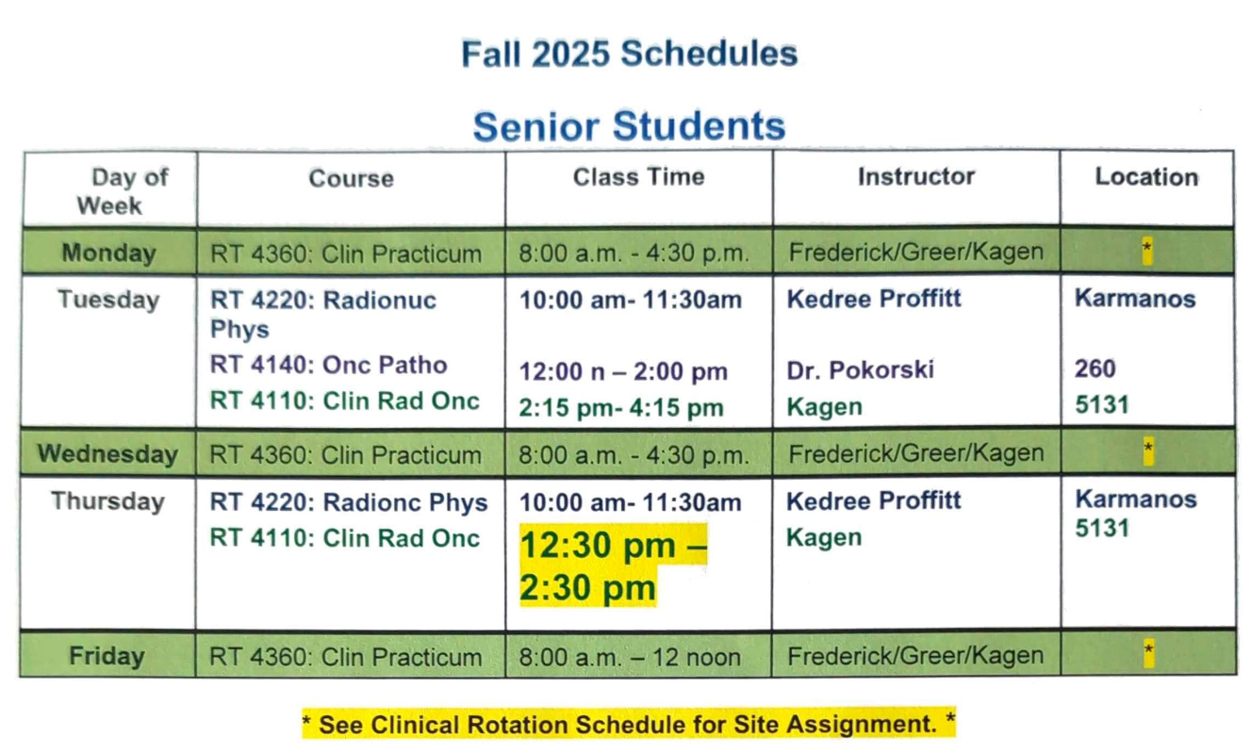

Slide 7
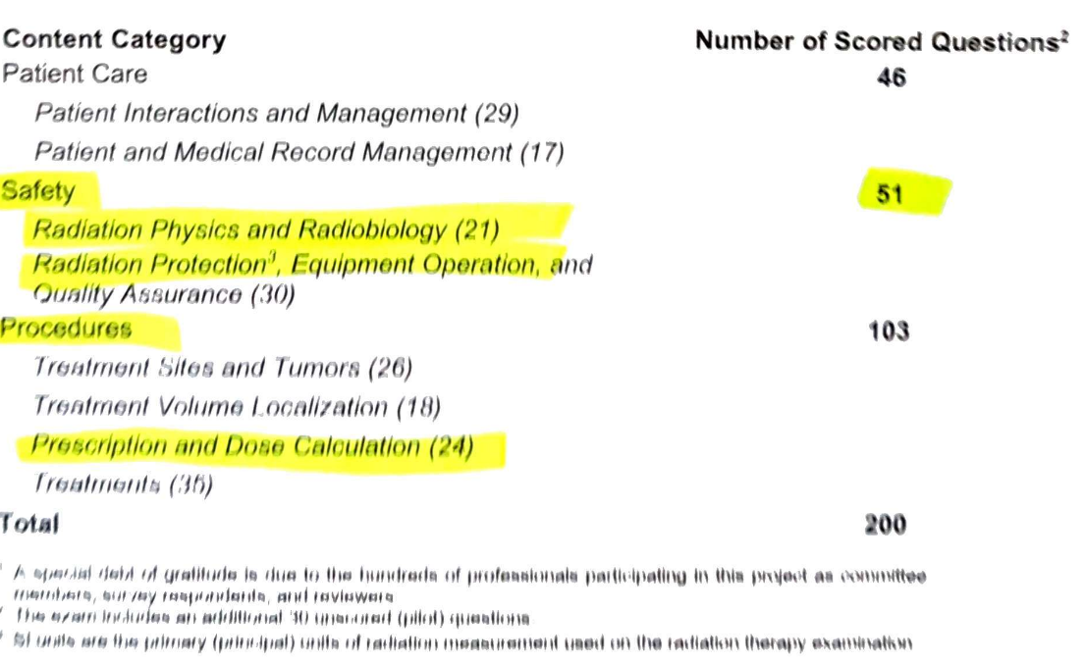

Slide 8
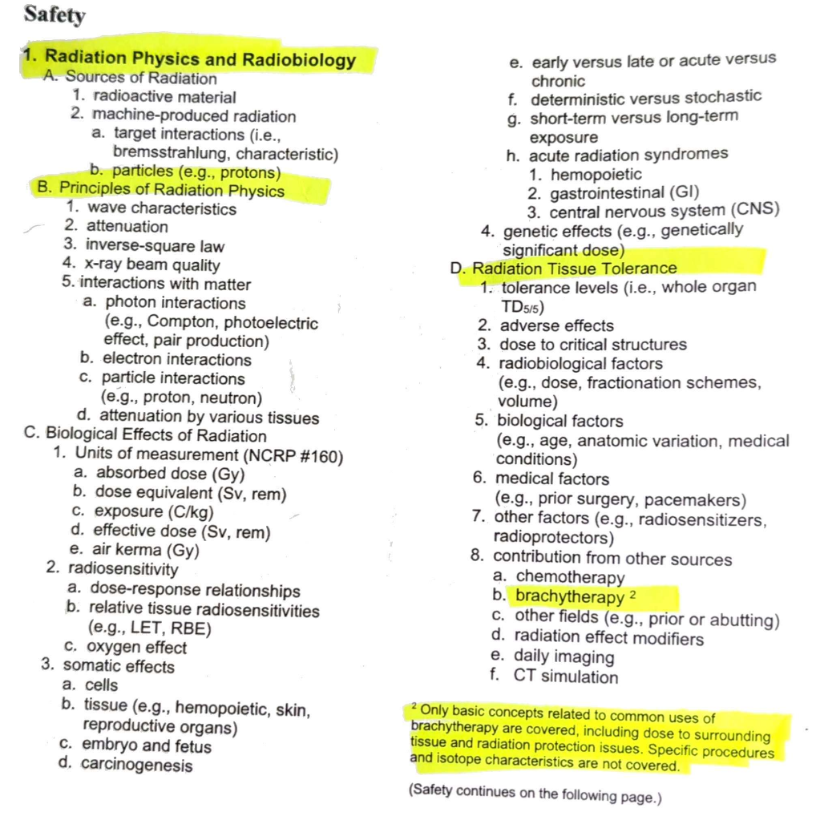
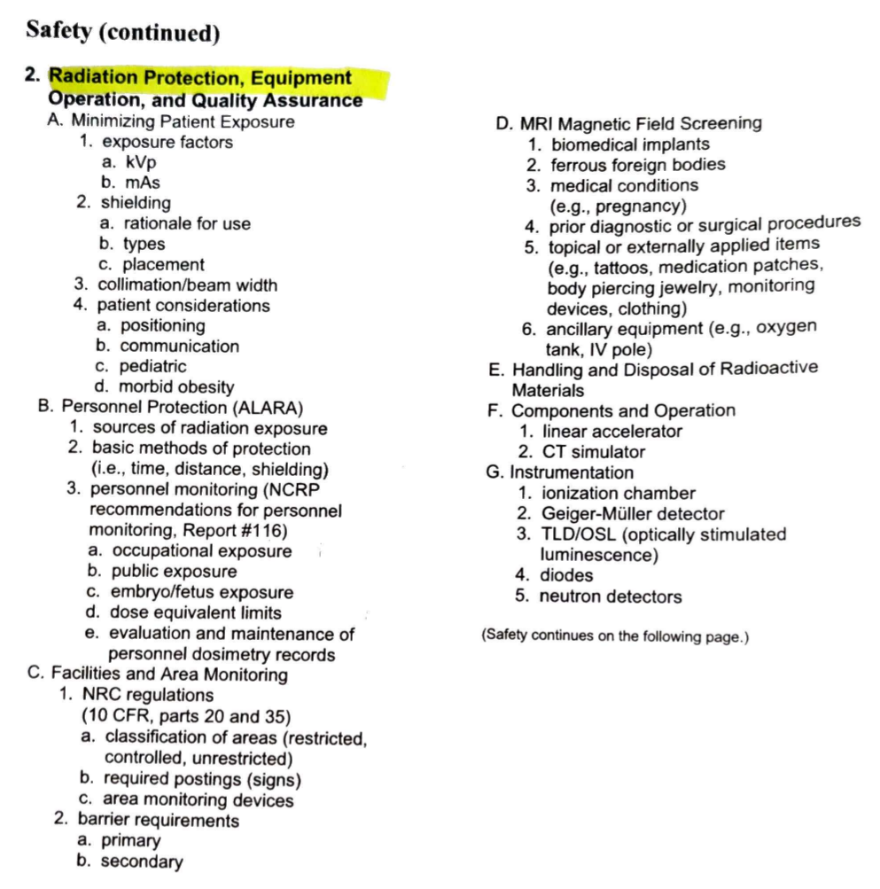
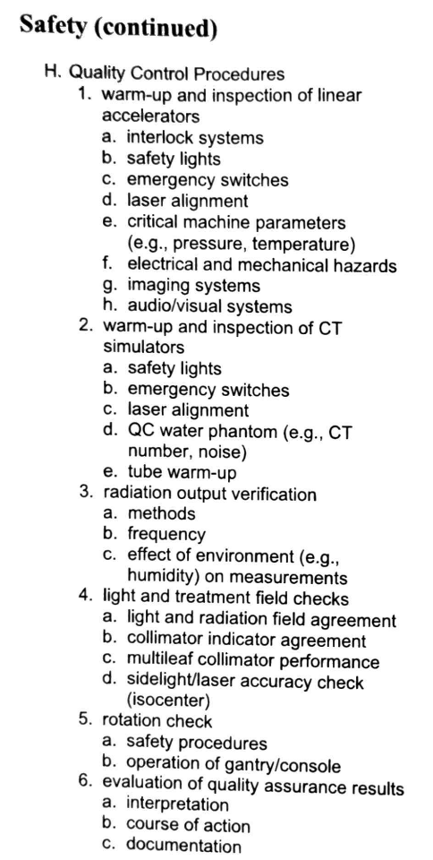

Slide 9
